Slide 1

Using JavaScript And Bootstrap
Notes Taking Website
Chandan Singh
Priyanshu Shahi
Gaurav Sunal

Slide 2

WORK PLAN
The first step is working on the project by ourselves. Discuss and counter the short comings among the team members. Secondly, surfing the internet and looking for some meaningful solutions from some websites like GeeksforGeeks, Stack Overflow, GitHub, and YouTube and discussing with our project guide.

Slide 3
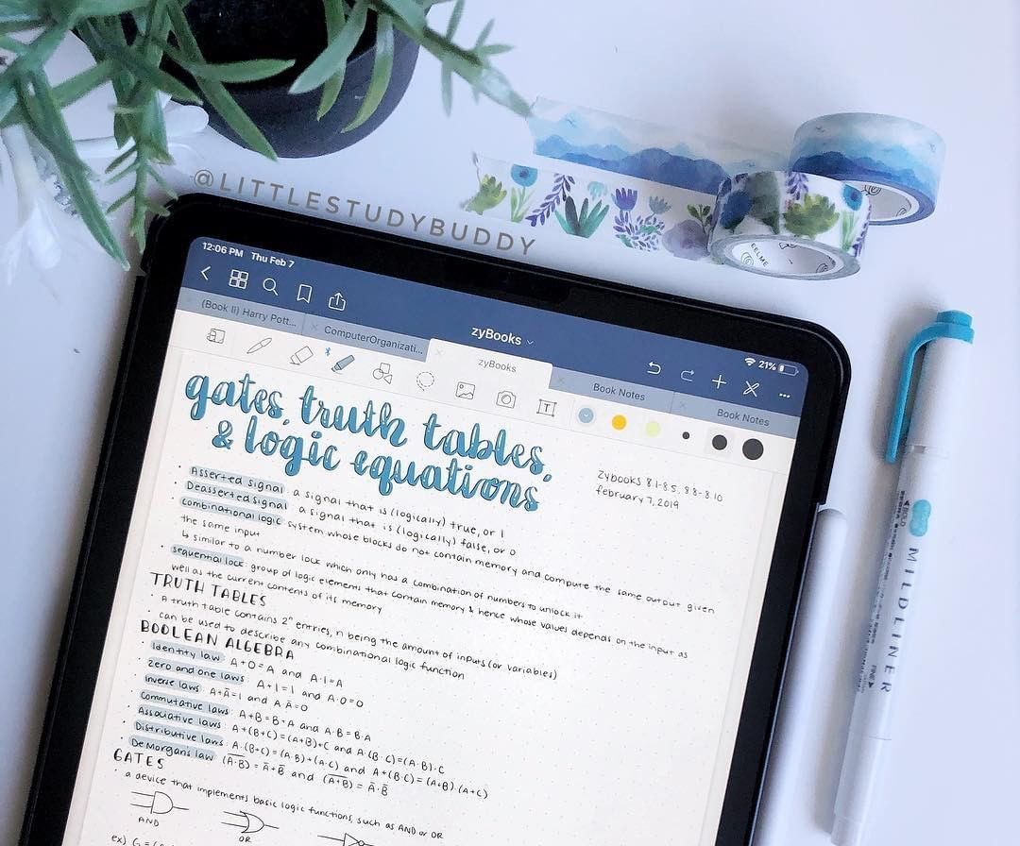
ABOUT
The project we are building is “Note Taking Website App Using Pure JavaScript.” We all have a notes app on our mobiles or laptop. Note-taking websites are the online equivalent of notebooks, and because they are digital, they can do more for you than paper ever could.

Slide 4

OBJECTIVES
The objectives of notes taking website for Real-Time Applications are given below:
Its safe time and paper.
Its increase the speed while taking notes.
Increase information at less time.
Improve & Increase typing speed.
Easy to use.

Slide 5

FEATURES OF THE NOTES TAKING WEBSITE
We all have a notes app on our mobiles or laptop. Note-taking websites are the online equivalent of notebooks, and because they are digital, they can do more for you than paper ever could.
We all have a notes app on our mobiles or laptop. Note-taking websites are the online equivalent of notebooks, and because they are digital, they can do more for you than paper ever could.
Easy to use any time any where

Slide 6
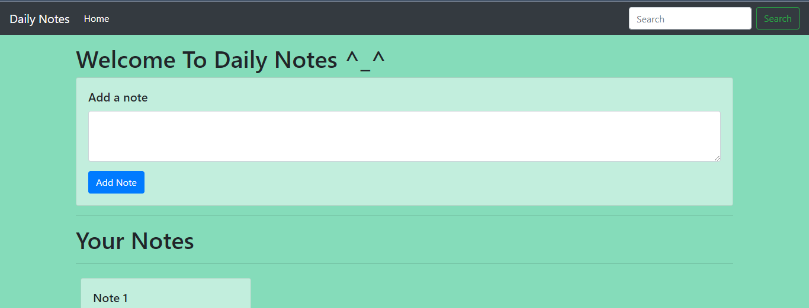
UI-INTERFACE

Slide 7
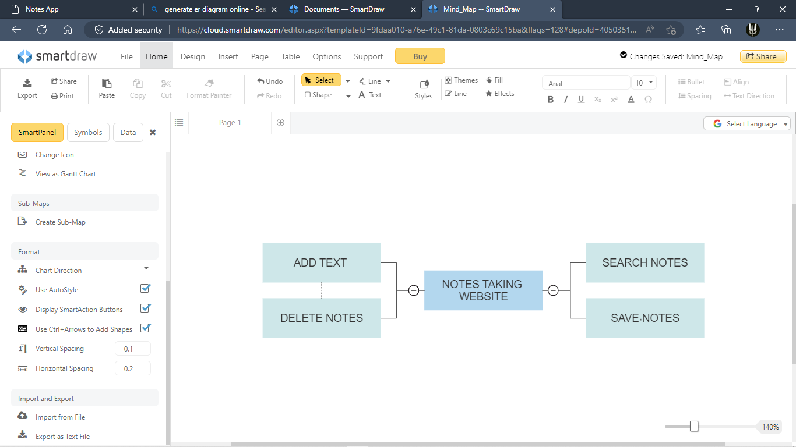
ER-DIAGRAM

Slide 8
LIMITATIONS
Can’t Mark a notes as important.
Can’t highlight as important .
Separate notes by user.
Sync and host to web server.

Slide 9
CODE:
https://github.com/chandan-koranga/notes-taking-website.git
PROJECT LINK:
Notes App (notes-taking-webapp.netlify.app)

Slide 10
THANK YOU

